Slide 1
Property Price Prediction Using Different Python Libraries
Presented by :-
Nitesh Namdev

Slide 2
Abstract :-
The House Price Prediction project endeavors to forecast residential property prices without employing machine learning techniques. Using a comprehensive dataset containing historical real estate data, the project focuses on traditional statistical methods and analytical tools for analysis. Data preprocessing involves cleaning and organizing the dataset to enhance its quality and relevance. Descriptive statistics and exploratory data analysis (EDA) are utilized to uncover patterns and trends within the data. Through careful feature selection and analysis, the project aims to develop a predictive model based on conventional statistical approaches. The resulting model provides a transparent and interpretable framework for estimating house prices, catering to scenarios where machine learning may not be the preferred solution. This project highlights the significance of foundational statistical methods in predicting house prices and contributes to a broader understanding of data analysis in real estate.

Slide 3
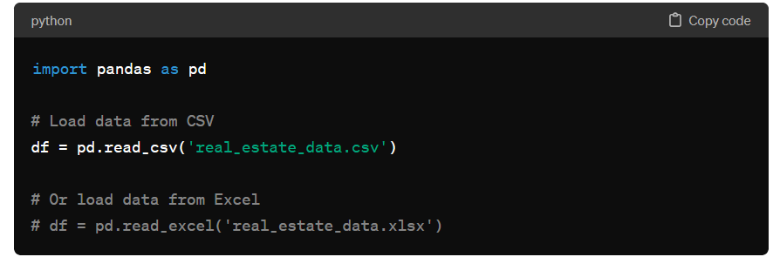
1. Loading The Data:
Task: Load the real estate pricing dataset into a Pandas Data Frame.
Python Library: Pandas
Explanation:
Load the dataset: Utilize the powerful Pandas library to import real estate pricing data.
Format: CSV or Excel - Choose the format that best suits your data source.
Pandas Data Frame: Efficiently organize and structure the dataset for seamless manipulation and analysis.
Facilitate Analysis: By loading data into a Pandas Data Frame, we ensure ease of access and manipulation, paving the way for comprehensive analysis.

Slide 4
2.Cleaning the Data:
Task: Clean the dataset by handling missing values, removing duplicates, and addressing any anomalies.
Python Library: Pandas
Explanation:
Ensure Data Quality: The process of cleaning data is crucial to ensure the reliability and accuracy of analyses.
Handling Missing Values: Identify and manage missing data to prevent skewed results.
Removing Duplicates: Eliminate redundant entries to maintain dataset integrity.
Addressing Anomalies: Identify and rectify any anomalies or inconsistencies in the dataset for reliable insights.

Slide 5
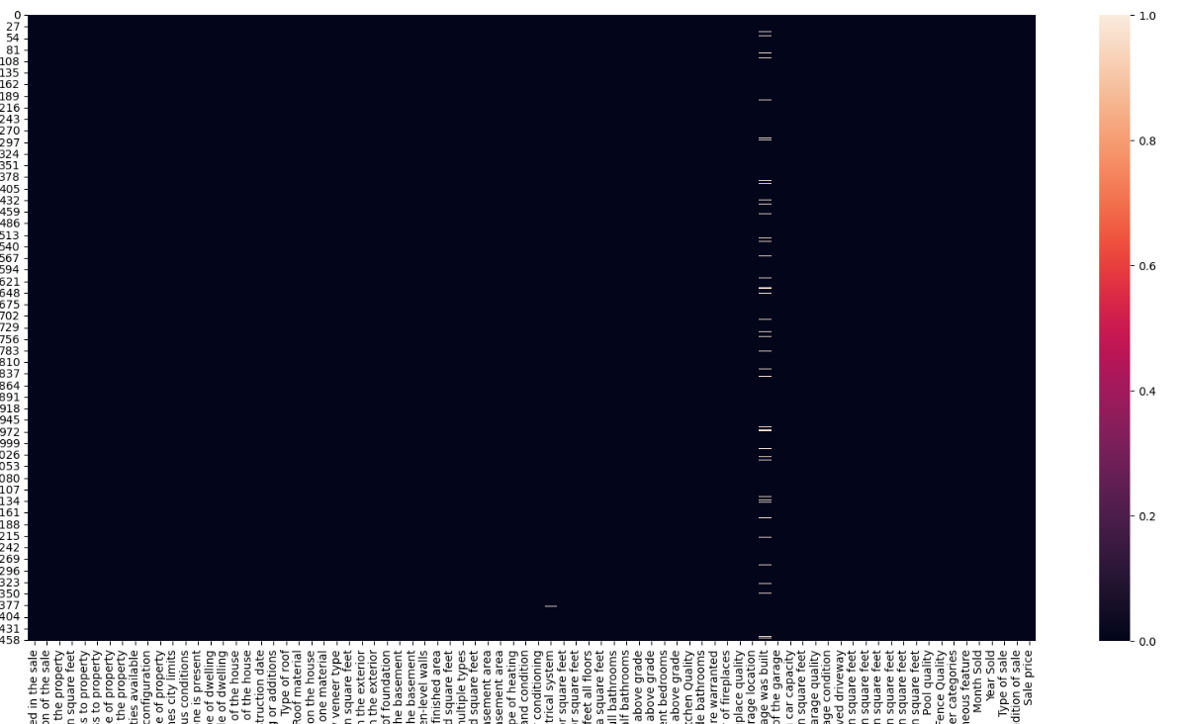
Missing Values:

Slide 6
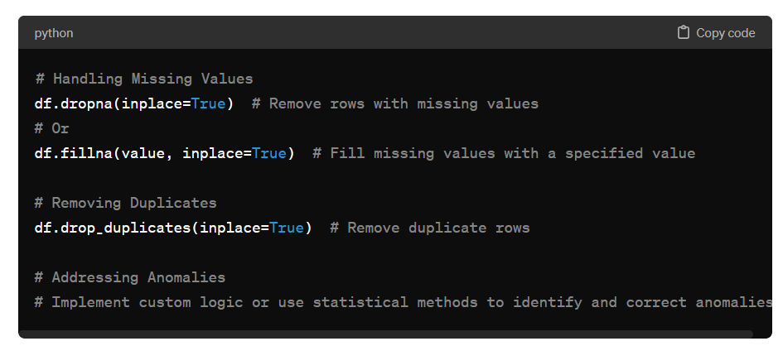
Pandas Function:
Reliable Analysis: Ensure the accuracy and reliability of your analytical results.
Improved Decision-Making: Clean data leads to better-informed decisions based on trustworthy insights.

Slide 7

Chart without Missing Values:

Slide 8
3. Univarite analysis:
Task: Explore individual variables to understand their distributions and characteristics.
Python Libraries: Matplotlib, Seaborn
Explanation:
Objective: Gain insights into the distribution and characteristics of key variables, such as house prices.
Techniques: Utilize statistical methods and visualizations like histograms, kernel density plots, or other graphical representations.
Data Exploration: Understand the central tendency, spread, and shape of the distribution for a single variable.
Visualizing Data:
Histograms: Visual representation of the distribution of numerical data.
Kernel Density Plots: Smoothed representation of the data distribution.
Box Plots: Displaying the distribution's central tendency and spread.

Slide 9
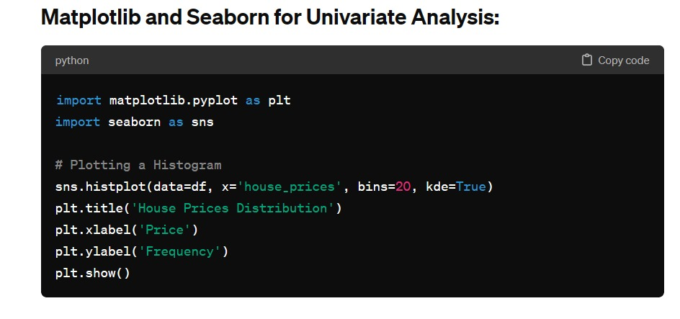
Matplotlib and Seaborn for Univariate Analysis:
Benefits of Univariate Analysis:
Identify Patterns: Discover patterns and trends within a single variable.
Outlier Detection: Recognize outliers that may affect overall analysis.
Data Understanding: Develop a foundational understanding of individual variable characteristics.

Slide 10
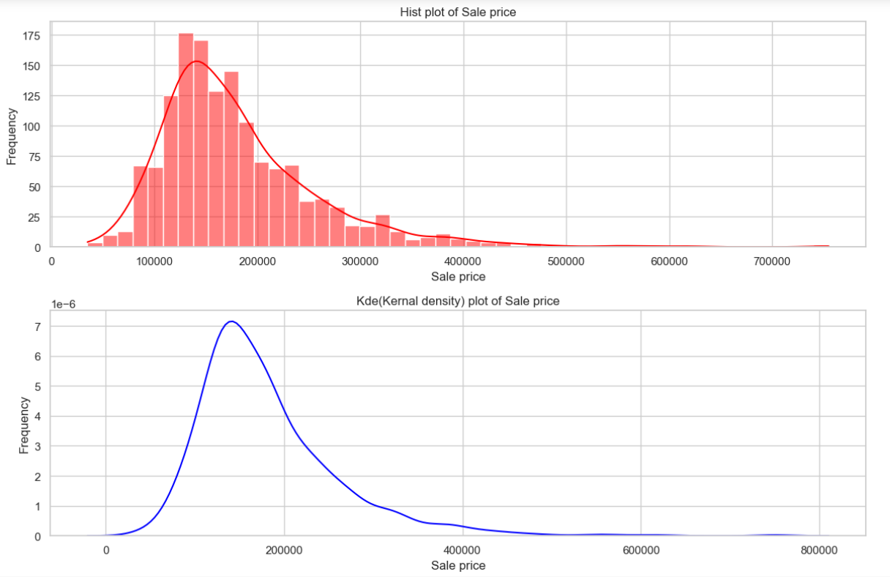
Univariate Analysis:

Slide 11
4. Multivariate Analysis:
Task: Investigate relationships between multiple variables, especially those impacting house prices.
Python Libraries: Matplotlib, Seaborn
Explanation:
Objective: Understand how various features relate to each other, especially in influencing house prices.
Approach: Perform multivariate analysis to explore correlations and dependencies between different features.
Techniques: Utilize visualization tools such as correlation matrices and scatterplot matrices for a comprehensive view.
Visualizing Relationships:
Correlation Matrices: Display the strength and direction of relationships between numerical variables.
Scatterplot Matrices: Visualize scatterplots for multiple variables, allowing a quick assessment of relationships and trends.

Slide 12
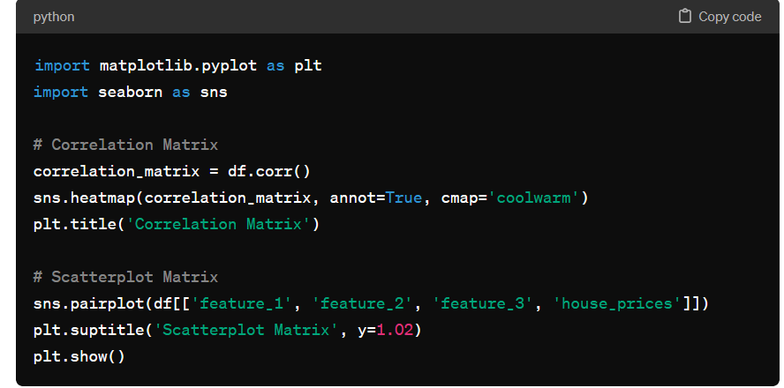
Matplotlib and Seaborn for Multivariate Analysis:
Benefits of Multivariate Analysis:
Identify Dependencies: Discover how different features interact and influence each other.
Feature Selection: Determine which variables contribute most significantly to house prices.
Holistic View: Gain a comprehensive understanding of the interplay between various factors.

Slide 13
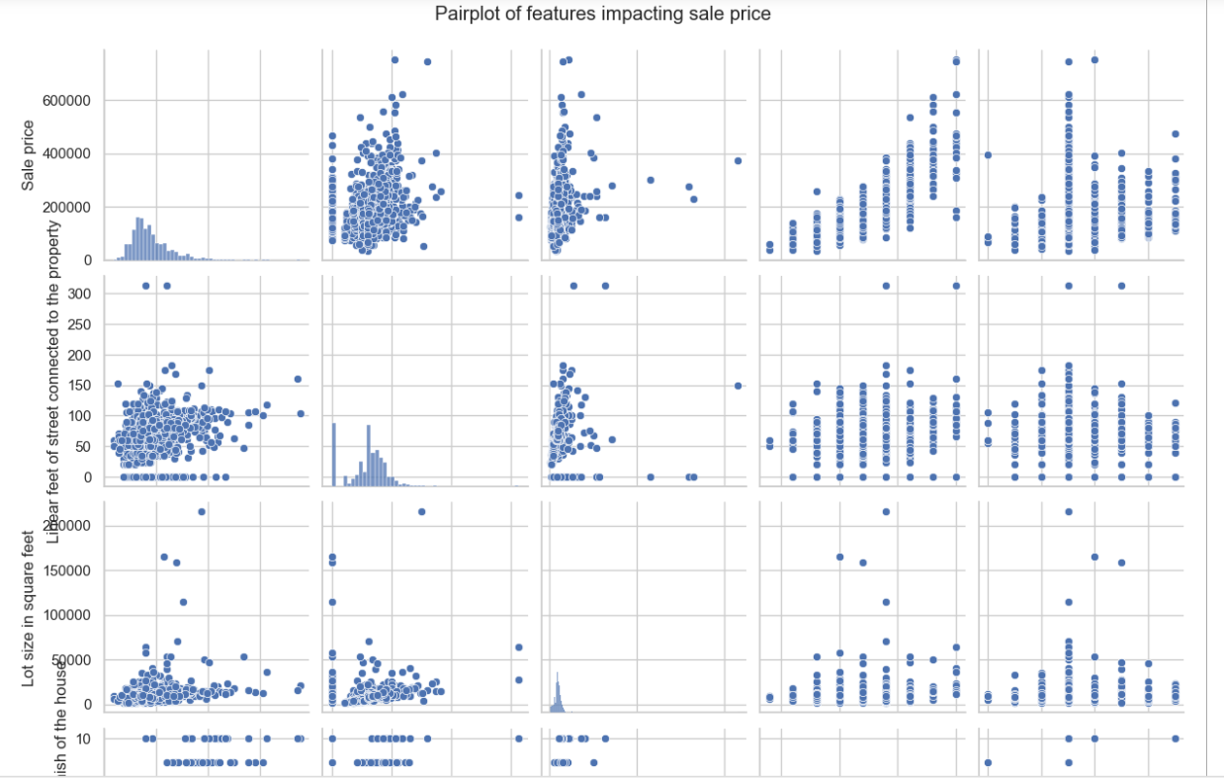
Multivariate Analysis:

Slide 14
5. Feature Engineering and Size Impact:
Task: Further analyze the impact of features and size on house prices.
Python Libraries: Pandas, Matplotlib, Seaborn
Explanation:
Objective: Explore how key features and size-related variables influence house prices.
Approach: Conduct analysis on features like the number of bedrooms, bathrooms, square footage, etc.
Techniques: Utilize Pandas for data manipulation and Matplotlib, Seaborn for visualization.
Exploring Relationships:
Box Plots: Visualize the distribution of house prices across different categories (e.g., number of bedrooms).
Scatter Plots: Understand the relationship between continuous variables (e.g., square footage) and house prices.

Slide 15
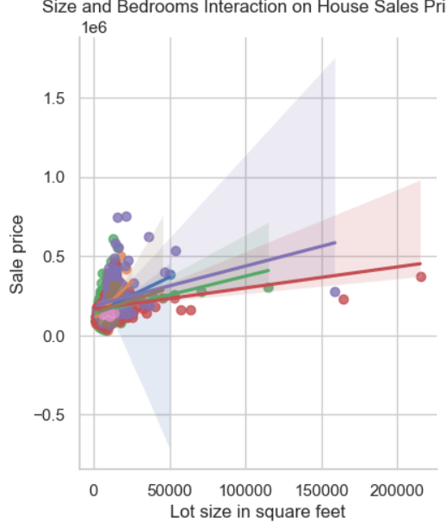
Feature Engineering and Size Impact:

Slide 16
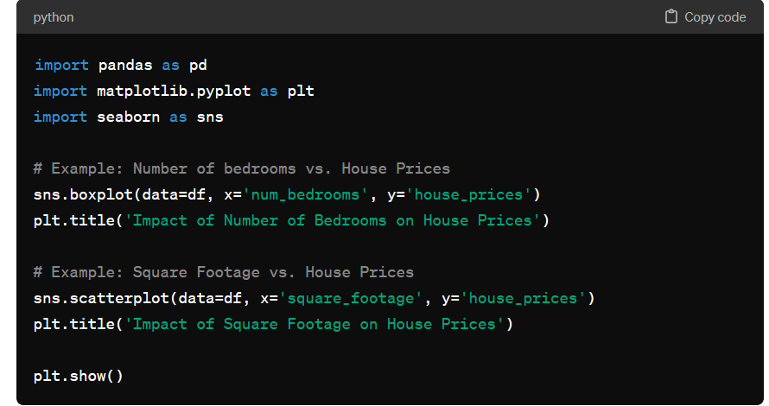
Analyzing Key Features:
Benefits of Feature Engineering:
Improved Predictions: Enhance the model's predictive power by introducing new relevant features.
Identify Influential Features: Understand which features contribute most significantly to the valuation.
Customized Insights: Tailor your analysis to the specific characteristics of the real estate dataset.

Slide 17
6. Market Trends and Historical Pricing:
Task: Explore historical pricing trends over time and understand market influences.
Python Libraries: Matplotlib, Seaborn
Explanation:
Objective: Analyze the dataset temporally to uncover trends in house prices over different periods.
Approach: Utilize time-based analysis to understand how external factors, like economic indicators, influence these trends.
Techniques: Leverage Matplotlib and Seaborn for temporal visualizations.
Exploring Temporal Trends:
Line Plots: Visualize how house prices change over time to identify trends.
Seasonal Analysis: Explore patterns that may repeat over specific periods.
Correlation with Economic Indicators: Assess how external factors coincide with pricing trends.

Slide 18
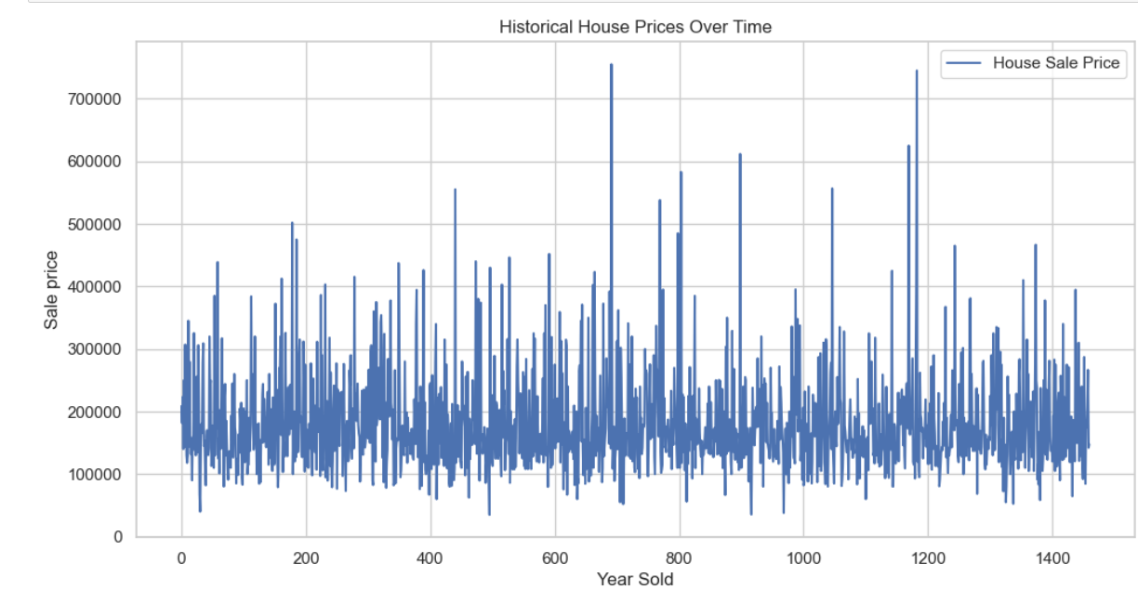
Market Trends and Historical Pricing:

Slide 19
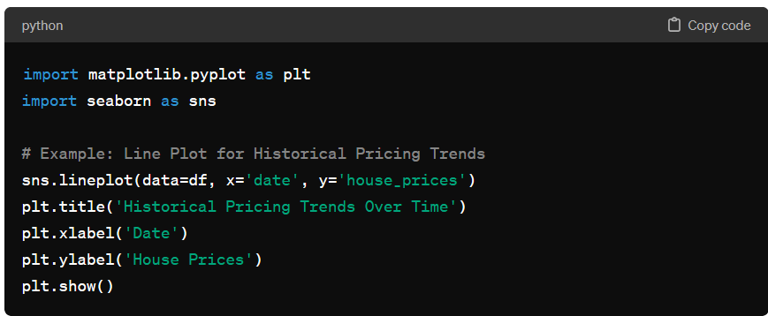
Temporal Analysis:
Benefits of Historical Pricing Analysis:
Market Insight: Understand the dynamics of the real estate market over time.
Predictive Modeling: Use historical trends to inform future predictions.
Identify Cyclic Patterns: Recognize repeating trends or seasonal fluctuations.

Slide 20
7. Customer Preferences and Amenities:
Task: Investigate how customer preferences and amenities impact house prices.
Python Libraries: Matplotlib, Seaborn
Explanation:
Objective: Examine the dataset to understand how specific amenities impact house prices and analyze customer feedback to gauge perceived value.
Approach: Utilize Matplotlib and Seaborn for visualizations and analysis.
Techniques: Explore the relationship between amenities (e.g., swimming pool, garage) and house prices.
Exploring Customer Preferences:
Box Plots: Visualize the impact of amenities on house prices.
Customer Feedback Analysis: Utilize reviews or feedback data to understand customer perceptions.
Comparative Analysis: Compare the influence of different amenities on pricing.

Slide 21
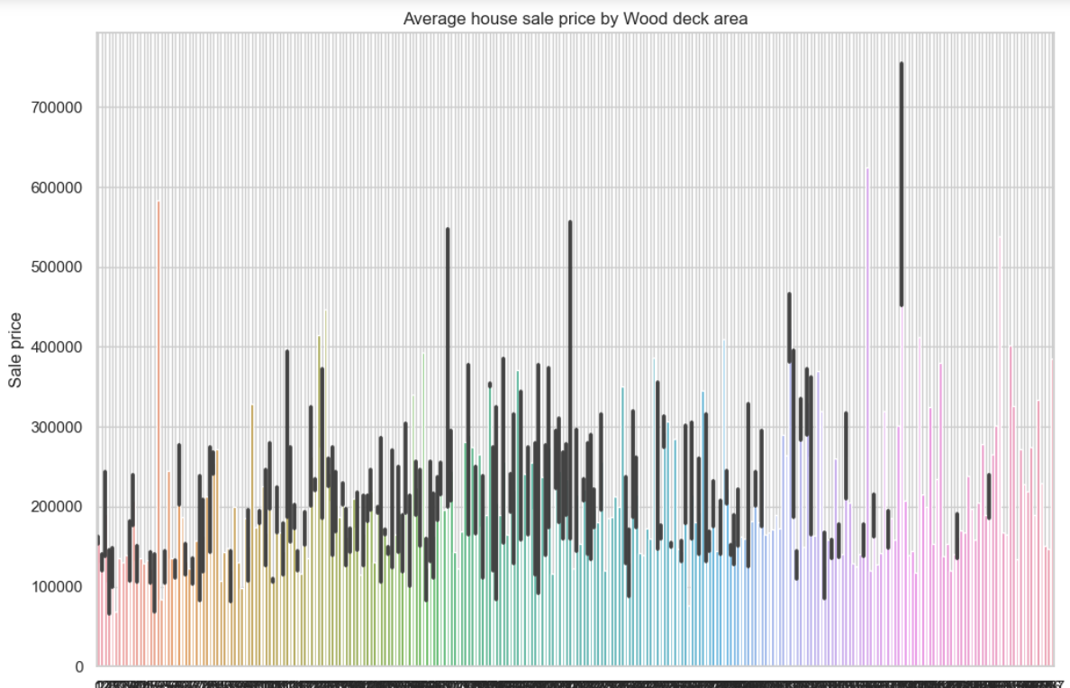
Customer Preferences and Amenities:

Slide 22
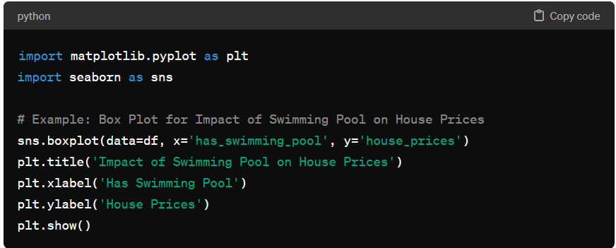
Analyzing Amenities:
Benefits of Customer Preferences Analysis:
Market Positioning: Understand how specific amenities contribute to a property's market position.
Pricing Strategy: Adjust pricing based on the perceived value of amenities.
Competitive Advantage: Highlight unique features that attract buyers.

Slide 23
8. Final Conclusion:
This comprehensive real estate pricing analysis has provided valuable insights into various aspects of the dataset. From loading and cleaning to in-depth exploratory analyses and geospatial considerations, we've equipped ourselves with a thorough understanding of the factors influencing house prices. Each step has contributed to a holistic view, laying the groundwork for data-driven decision-making in the dynamic real estate market.
Empowered with these insights, we are well-positioned to make informed decisions, tailor marketing strategies, and enhance predictive models for a competitive advantage in the real estate landscape.

